Slide 1
PUBLIC TRANSPORTATION OPTIMIZATION
NAME: POOJA N
REG NO:610821106070
INTRODUCTION
Public transportation is the lifeblood of modern cities, providing an efficient and sustainable means of moving people from one place to another. In today's rapidly growing urban environments, the demand for efficient public transportation systems has never been greater. As cities expand, so does the need for innovative solutions to address congestion, reduce emissions, and enhance the overall quality of life for their residents.
This presentation will explore the concept of optimizing public transportation, focusing on strategies and technologies that can revolutionize the way people move within cities. Our objective is to provide a small glimpse into the potential of public transportation optimization, with an emphasis on sustainability, accessibility, and improved urban mobility.

Slide 2
ABSTRACT
The Public Transportation Optimization System is a comprehensive project aimed at enhancing the efficiency and accessibility of public transportation networks in urban areas. This system leverages modern technologies and data analytics to provide real-time solutions for commuters and transit authorities. By optimizing routes, schedules, and passenger experiences, it contributes to reducing congestion, emissions, and travel times, ultimately promoting sustainable urban mobility.
Modules:
1. Data Collection and Analysis:
- Collect data on passenger traffic, vehicle locations, and historical travel patterns.
- Utilize data analytics to identify congestion hotspots and peak travel times.
- Generate insights to inform decision-making.
2. Real-time Tracking and Passenger Information:
- Implement GPS tracking on vehicles for real-time location updates.
- Develop a user-friendly mobile app and web portal to provide passengers with accurate arrival times and route information.
- Enable notifications for delays or disruptions.

Slide 3
3. Route Optimization:
- Use advanced algorithms to optimize bus and train routes based on real-time data and demand patterns.
- Minimize travel times, reduce wait times, and improve coverage.
- Consider environmental factors to promote eco-friendly routes.
4. Fare Integration and Payment System:
- Integrate multiple modes of public transport into a unified payment system.
- Develop contactless payment options, including mobile wallets and smart cards.
- Ensure affordability and convenience for passengers.
5. Traffic Management and Signal Integration:
- Collaborate with traffic management authorities to implement signal prioritization for public transport vehicles.
- Reduce delays and improve transit speed by minimizing stops at red lights.

Slide 4
6. Safety and Security:
- Implement surveillance systems on vehicles and at transit stations.
- Develop an emergency response module for rapid assistance in case of accidents or incidents.
- Educate passengers on safety measures and emergency protocols.
7. Environmental Sustainability:
- Introduce eco-friendly vehicles, such as electric or hybrid buses.
- Monitor and report on emissions reductions and environmental impact.
- Encourage the use of public transportation as a green alternative to private vehicles.
8. User Feedback and Continuous Improvement:
- Collect feedback from passengers through surveys and app ratings.
- Use feedback to make ongoing improvements to routes, schedules, and services.
- Implement a dynamic system that adapts to changing urban needs.

Slide 5
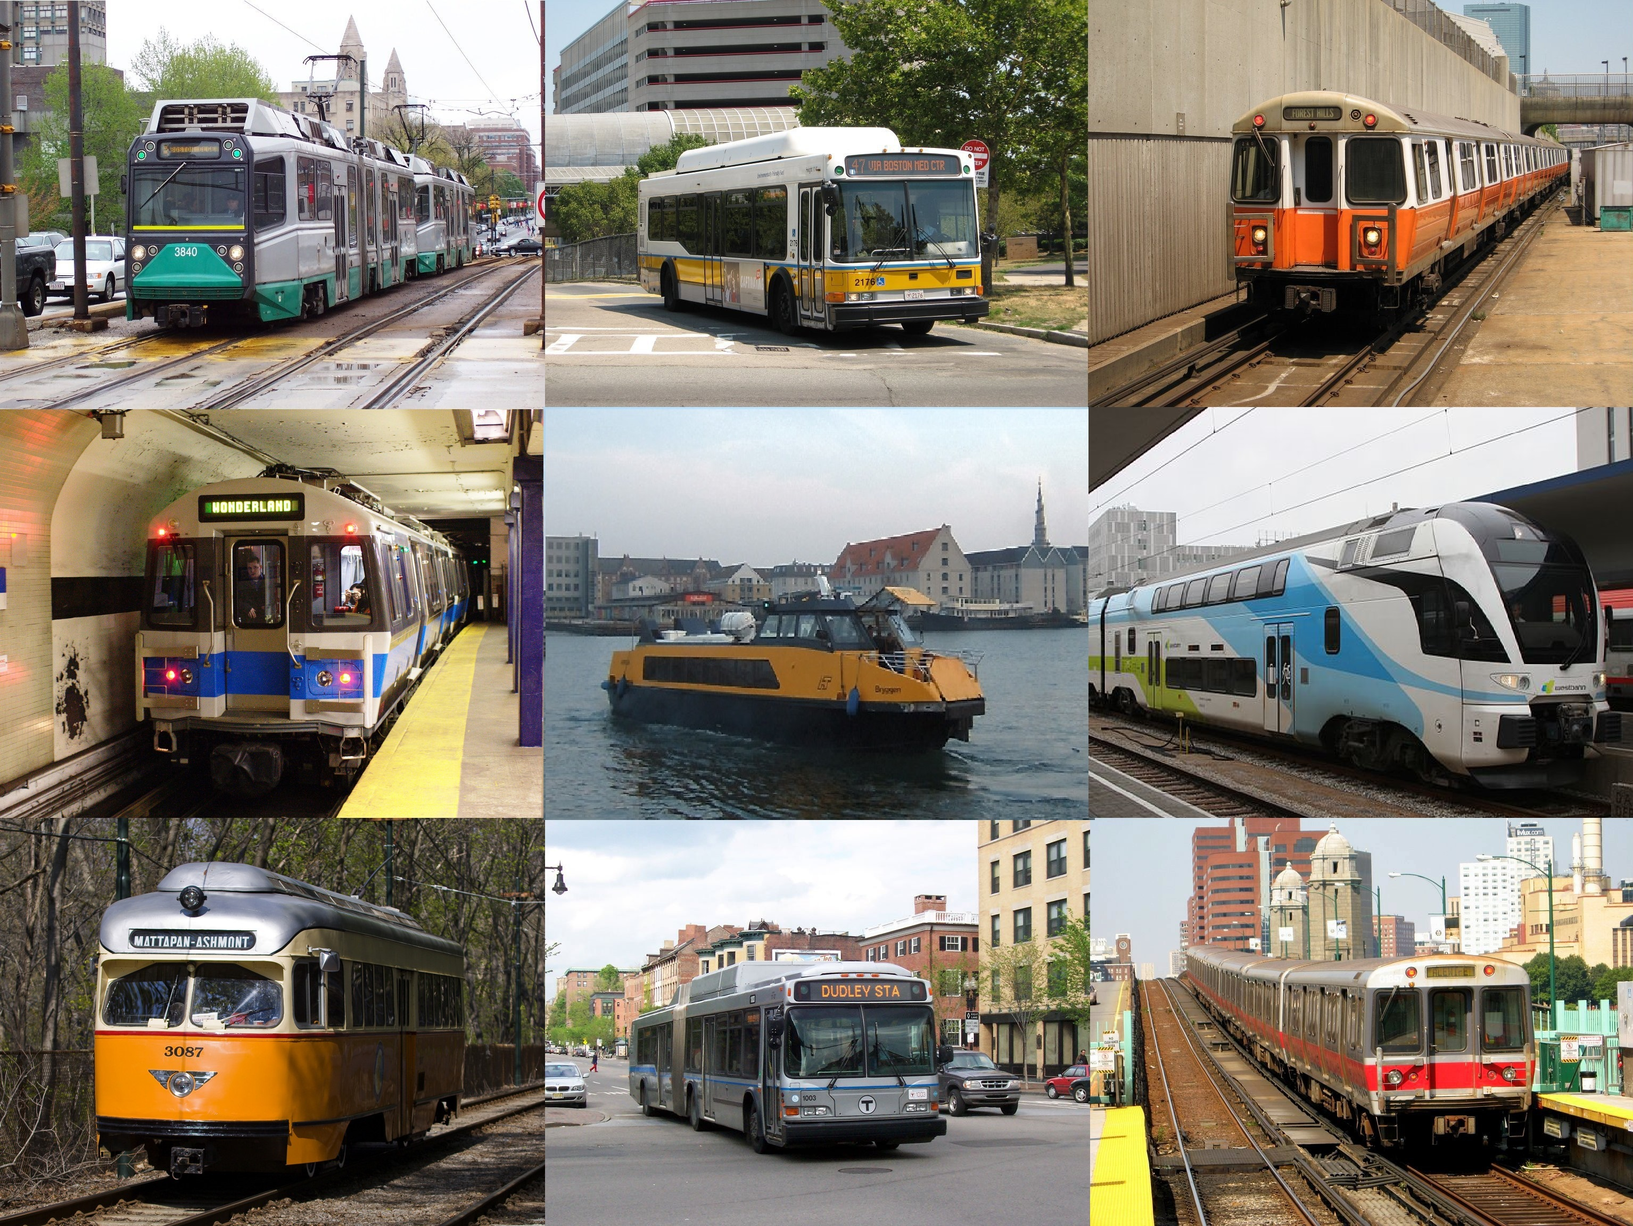
9. Admin Dashboard and Reporting:
- Provide transit authorities with an admin dashboard for monitoring system performance and managing resources.
- Generate reports on ridership, revenue, and environmental impact for data-driven decision-making.
10. Public Awareness and Promotion:
- Develop marketing campaigns to promote the benefits of public transportation.
- Educate the public on using the system effectively and reducing their carbon footprint.
This Photo by Unknown Author is licensed under CC BY-SA

Slide 6
Problem Statement:
Inefficient public transportation systems often lead to overcrowded buses and trains, inconsistent schedules, and dissatisfied commuters.
Solution Overview:
Create a smart public transportation network that integrates real-time data, predictive analytics, and personalized services to optimize routes, schedules, and passenger experience.
Key Features:
1. Real-time Data Integration:
Implement IoT devices, sensors, and GPS trackers on buses, trains, and stops to collect real-time data on passenger count, vehicle location, and traffic conditions.

Slide 7
2. Predictive Analytics:
Utilize machine learning algorithms to analyze historical and real-time data, predicting passenger demand at different times and locations. This helps in optimizing routes and schedules dynamically.
3. Dynamic Routing and Scheduling:
Develop algorithms that adjust routes and schedules in real-time based on demand forecasts. This ensures that vehicles are deployed efficiently, avoiding overcrowding and reducing waiting times.
4. Personalized Commuter Services:
Create a mobile app that allows commuters to set preferences, such as preferred routes, seating preferences, and notifications for delays. The app can provide real-time updates, alternative routes, and estimated arrival times tailored to individual preferences.

Slide 8
5. Multi-Modal Integration:
Integrate various modes of transport, including buses, trains, subways, bikes, and ride-sharing services, into a unified platform. Enable seamless transfers and provide incentives for using multiple modes of transport within a single journey.
6. Contactless Payments and Boarding:
Implement contactless payment systems and automated boarding processes using QR codes or RFID cards. This reduces boarding time, making the transportation system more efficient.
7. Crowd Management and Safety Measures:
Use AI-powered cameras and sensors to monitor crowd density in stations and vehicles. Implement safety measures such as automated passenger counting to enforce capacity limits and ensure social distancing.

Slide 9
8. Feedback Loop and Continuous Improvement:
Encourage commuter feedback through the app to identify issues and areas of improvement. Use this feedback to make data-driven decisions, refine algorithms, and enhance the overall transportation experience.
Benefits:
Efficient Operations: Optimized routes and schedules lead to reduced operational costs and increased efficiency.
Improved Commuter Experience: Personalized services and real-time updates enhance commuter satisfaction.
Environmental Impact: Reduced congestion and optimized routes contribute to lower emissions and a greener environment.
Data-Driven Decision Making: Data analytics enable evidence-based decision-making for future planning and expansion.

Slide 10
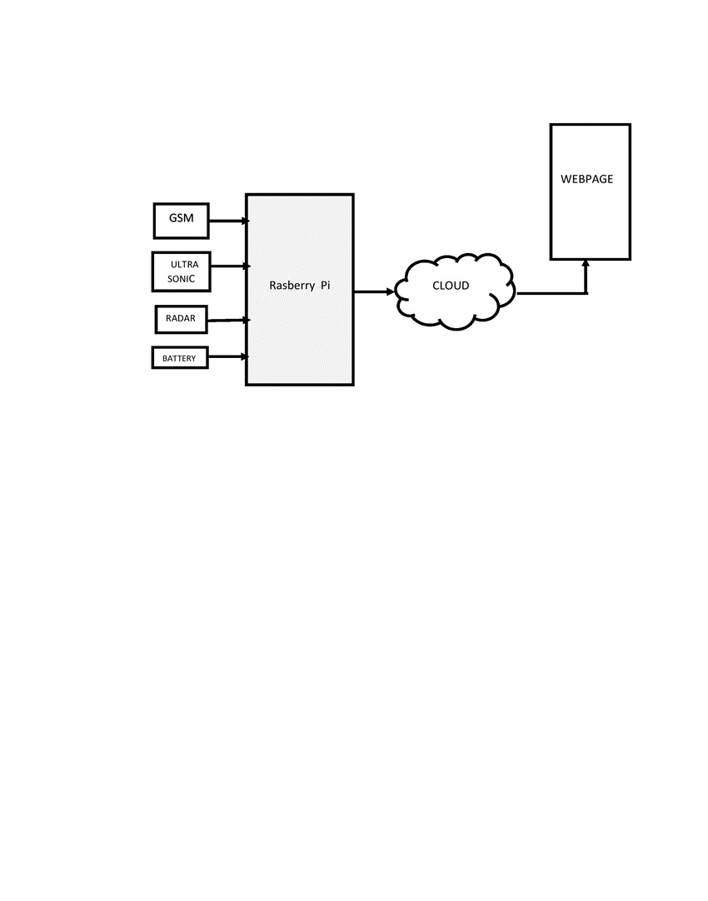
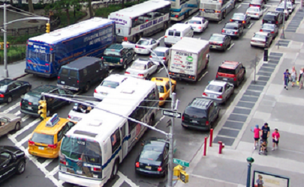
BLOCK DIAGRAM

Slide 11
WORKING MODULE
1. Location Tracking:
- Utilize GPS or other location tracking technologies to collect real-time data on the buses or vehicles in your public transportation system.
- Consider using libraries like `geopy` or `GPSD` in Python to gather location data.
2. Rider Database:
- Create a database to store information about riders, including their boarding and alighting locations, timestamps, and unique identifiers.
- You can use a relational database like SQLite or MySQL, or a NoSQL database like MongoDB.
3. Data Collection:
- Develop a data collection system to record when and where riders board and alight from vehicles. You can use sensors or mobile applications for this purpose.
- Integrate the data collected with the rider database.

Slide 12
4. Route Optimization:
- Use the location data to optimize bus or vehicle routes. Consider implementing algorithms like Dijkstra's or A* for route planning.
- Take into account traffic conditions and real-time location updates to make dynamic adjustments.
5. Real-time Updates:
- Create a system to provide real-time updates to riders about the estimated time of arrival (ETA) and any delays.
6. Web Interface:
- Build a web application that allows riders to access information about bus routes, ETAs, and delays.
- Implement a dashboard for administrators to manage and visualize the collected data.

Slide 13
7. Data Analysis:
- Analyze the collected data to identify patterns and make data-driven decisions for route optimizations.
- Python libraries like Pandas and Matplotlib can help with data analysis and visualization.
8. Machine Learning (Optional):
- Implement machine learning models to predict future ridership and optimize routes based on historical data.
9. Security and Privacy:
- Implement security measures to protect rider data and ensure privacy compliance.
10. Documentation and User Manuals:
- Provide clear documentation and user manuals for both administrators and riders on how to use the system.

Slide 14
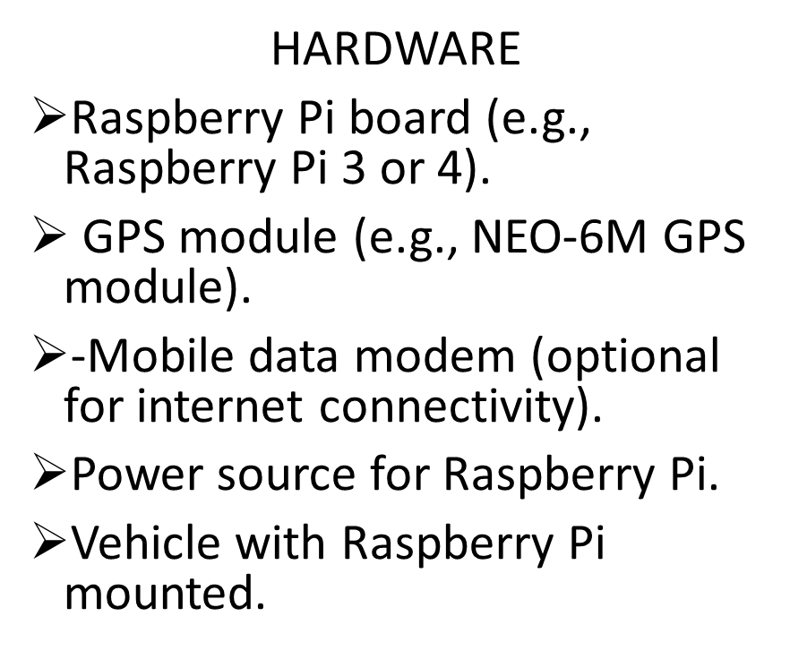
COMPONENTS
SOFTWARE
Python
Database system
Location tracking libraries
Web frameworks and libraries
Data analysis libraries
Machine learning
Security and privacy tools

Slide 15
RASPBERRY Pi
The Raspberry Pi is a series of small, affordable, single-board computers that have had a significant impact on the world of technology and education. Here's a brief overview of the Raspberry Pi:
Affordable Computing:
The Raspberry Pi Foundation, a UK-based charity, designed these compact computers to be affordable, making computing accessible to a broader audience. Raspberry Pi boards typically cost less than $50, making them an ideal choice for various projects and learning opportuneities.
Versatility:
Raspberry Pi boards are incredibly versatile. They are equipped with various ports for peripherals, like USB, HDMI, and audio, and can run a wide range of operating systems, including Raspberry Pi OS, a Linux-based distribution. This versatility makes them suitable for a wide array of applications, from basic computing tasks to more complex projects.

Slide 16
Educational Tool:
Raspberry Pi has had a profound impact on education, particularly in teaching programming and computer science. Many schools and enthusiasts use Raspberry Pi boards to learn about coding, hardware, and electronics. The low cost and compact size of these computers make them ideal for classroom settings.
Maker and DIY Projects:
Raspberry Pi has fueled a maker and DIY revolution. Enthusiasts and hobbyists use these boards to create projects like home automation systems, media centers, retro gaming consoles, and even robotics. The Raspberry Pi's GPIO (General Purpose Input/Output) pins allow for easy integration with sensors and other hardware components.
Community and Ecosystem:
The Raspberry Pi has a vibrant and active community of users and developers. This community provides support, shares project ideas, and contributes to the continuous development of software and hardware add-ons, such as HATs (Hardware Attached on Top).

Slide 17
Models and Upgrades:
Over the years, Raspberry Pi has released several models, each offering improvements in terms of performance, connectivity, and features. The Raspberry Pi 4, for example, introduced more powerful hardware, multiple USB ports, and dual 4K monitor support.
Use Cases:
Raspberry Pi can be used in a wide range of applications, including as a low-cost desktop computer, a home server, a media center using Kodi, a retro gaming machine with emulators, a network-attached storage (NAS) device, and much more.
IoT and Embedded Systems:
The Raspberry Pi is also popular for Internet of Things (IoT) projects and embedded systems. Its small size and low power consumption make it suitable for monitoring and controlling various devices and sensors.

Slide 18
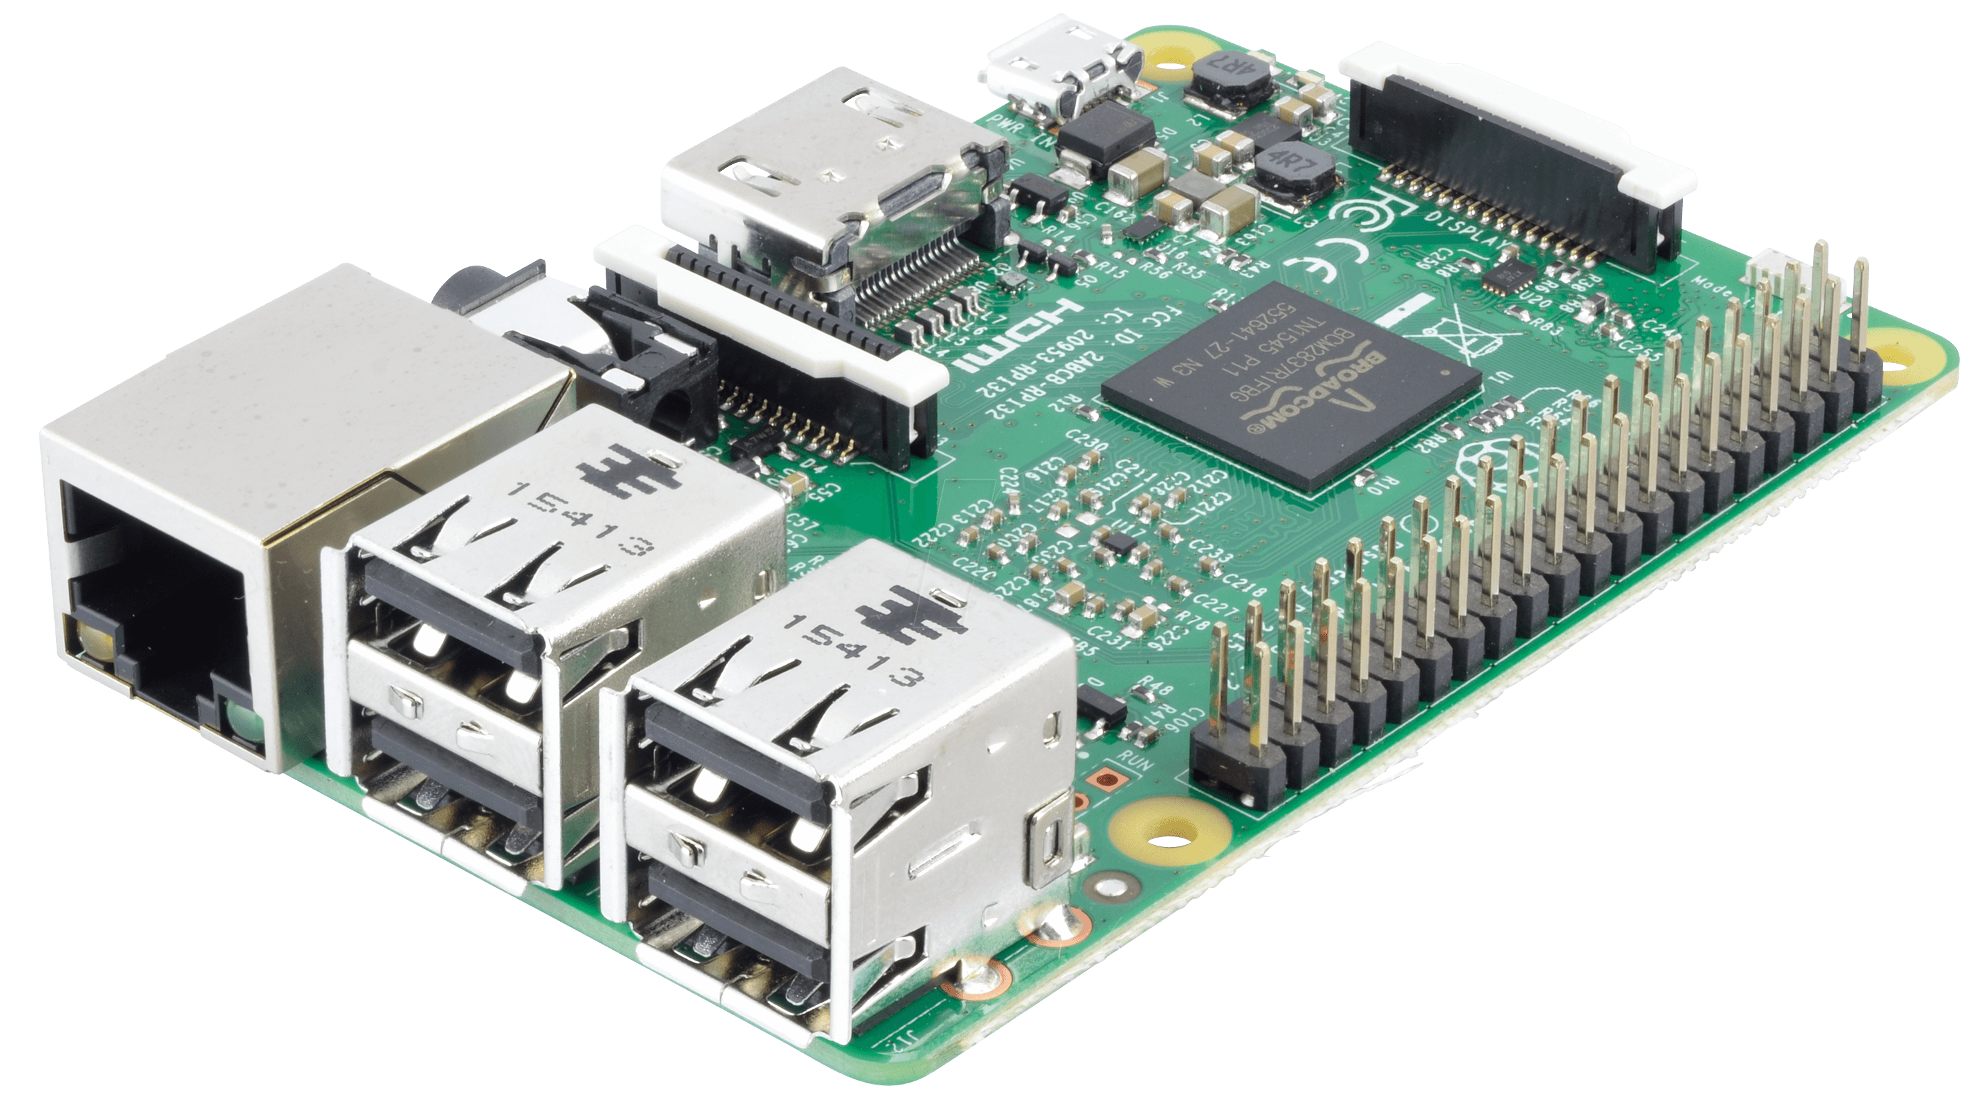
RASPBERRY Pi

Slide 19
GPS MODULE
GPS Technology:
GPS is a satellite-based navigation system comprising a constellation of satellites that continuously transmit signals containing time and location information. GPS modules receive these signals and use the information to calculate their position, velocity, and sometimes even altitude.
Components:
A typical GPS module includes a GPS receiver, an antenna, and often additional hardware for data processing and communication. The GPS receiver is responsible for decoding and processing signals from satellites, while the antenna captures those signals.
Accuracy:
The accuracy of GPS modules can vary depending on the quality of the module and the number of satellites it can access. Most GPS modules provide location accuracy within a few meters, but more advanced modules can achieve sub-meter or centimeter-level accuracy, especially when using correction services like DGPS (Differential GPS).

Slide 20
Applications:
GPS modules are used in a wide range of applications, including:
Navigation: In-car GPS systems, handheld GPS devices for hikers, and smartphone navigation apps all rely on GPS modules for location and route guidance.
Tracking: GPS modules are commonly used in asset tracking, vehicle tracking, and even pet tracking devices.
Geotagging: Digital cameras and smartphones use GPS modules to geotag photos with location information.
Surveying and Mapping: High-precision GPS modules are used in surveying and mapping for land, construction, and geospatial applications.
Agriculture: GPS modules are crucial in precision agriculture for tasks like guiding tractors and drones, optimizing planting, and monitoring crop health.
Emergency Services: First responders and emergency services use GPS for location determination in 911 calls and search and rescue operations.

Slide 21
Communication:
Many GPS modules can provide data output in various formats, including NMEA (National Marine Electronics Association) sentences, which contain information about latitude, longitude, altitude, and time. This data can be transmitted to other devices or systems through serial communication, USB, or wireless protocols like Bluetooth or Wi-Fi.
Power Consumption:
Power consumption varies depending on the module and its usage. Some modules are designed for low-power applications, such as IoT devices, and can operate for an extended period on a single battery.
Integration:
GPS modules are often integrated into larger systems and devices, such as smartphones, tablets, vehicle navigation systems, and wearable devices. However, standalone GPS modules are also available for use in custom projects and applications.

Slide 22
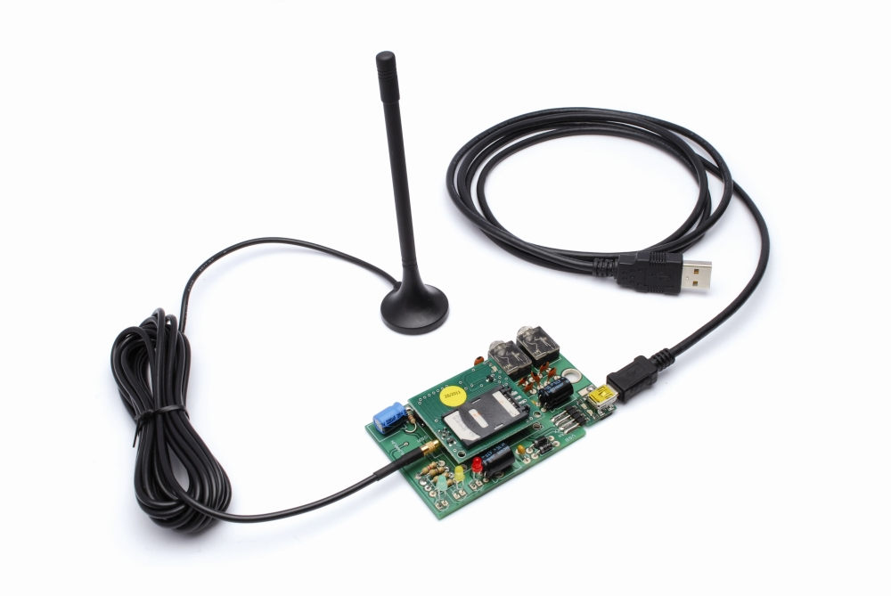
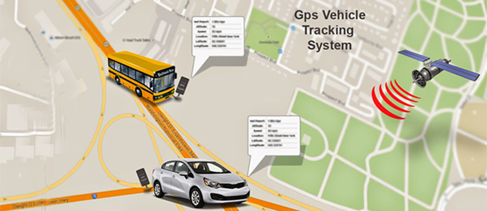
GPS MODULE
This Photo by Unknown Author is licensed under CC BY-SA-NC

Slide 23
ULTRASONIC SENSOR
Transmitter:
The ultrasonic sensor consists of a transmitter and a receiver. The transmitter emits a high-frequency sound wave, typically in the ultrasonic range (above 20 kHz).
Sound Wave Propagation:
The sound wave travels through the air until it encounters an object in its path.
Reflection:
When the sound wave hits an object, it bounces back toward the sensor.
Receiver:
The receiver in the sensor detects the reflected sound wave.
Time Measurement:
The sensor measures the time it takes for the sound wave to travel from the transmitter to the object and back to the receiver. This time measurement is crucial for calculating the distance to the object.

Slide 24
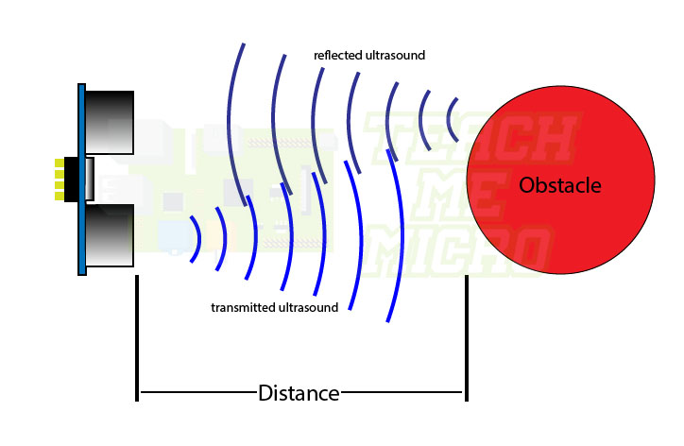
Distance Calculation: Using the speed of sound in the air (which is approximately 343 meters per second at 20°C or 68°F), the sensor calculates the distance to the object based on the time it took for the sound wave to return.
Distance Range: Ultrasonic sensors can measure distances typically ranging from a few centimeters to several meters, depending on the specific sensor model.
Accuracy: The accuracy of ultrasonic sensors depends on the model and environmental conditions. In general, they provide reliable distance measurements.

Slide 25
RADAR
Obstacle Detection and Collision Avoidance:
Radar sensors are used in buses, trams, and even autonomous vehicles to detect obstacles in the vehicle's path. These radar sensors can help prevent collisions by providing early warnings to the driver or initiating automatic emergency braking systems.
Adaptive Cruise Control (ACC):
Many modern buses and trains are equipped with radar-based adaptive cruise control systems. These systems use radar to maintain a safe following distance from the vehicle in front, adjusting the speed as needed. ACC can improve fuel efficiency and reduce the risk of rear-end collisions.
Crossing and Intersection Safety:
Radar systems can be used at railway crossings and intersections to detect approaching vehicles or pedestrians. When radar detects a vehicle or person in the vicinity, it can trigger warning signals, such as flashing lights and gates, to prevent accidents.

Slide 26
Level Crossing Monitoring:
In the context of rail transportation, radar technology can monitor level crossings to ensure that no vehicles or pedestrians are on the tracks when a train approaches. This helps to improve safety and reduce accidents at level crossings.
Track Condition Monitoring:
Radar can be used to assess the condition of railway tracks, checking for deformities, wear, and other issues that may affect train safety. Continuous monitoring helps identify maintenance needs promptly.
Platform Passenger Counting:
Radar sensors can be installed at public transportation platforms to count the number of passengers waiting for a train or bus. This information can be used for crowd management and service optimization.
People Counting:
Inside buses and trains, radar sensors can count passengers as they board and disembark. This data is valuable for service planning and resource allocation.

Slide 27
Obstacle Detection for Autonomous Vehicles:
In autonomous buses and other self-driving vehicles, radar is used as one of the sensors to detect and track nearby objects, ensuring safe navigation and collision avoidance.
Efficient Scheduling:
Radar-based traffic and passenger flow data can be used to optimize public transportation schedules, reduce congestion, and improve on-time performance.
Security:
Radar sensors can enhance security in public transportation by monitoring areas for unauthorized intrusions or suspicious activities.
Vehicle Inspection:
Radar-based technology can be used for safety inspections and maintenance checks on public transportation vehicles, helping to identify issues with the structure, brakes, or other critical components.

Slide 28
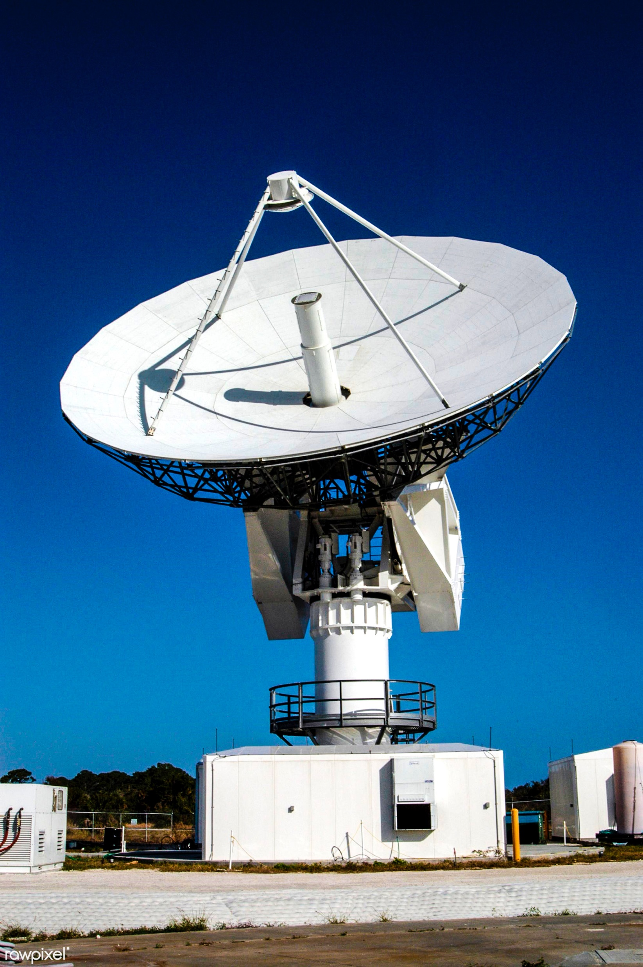
ULTRA SONIC SENSOR
RADAR

Slide 29
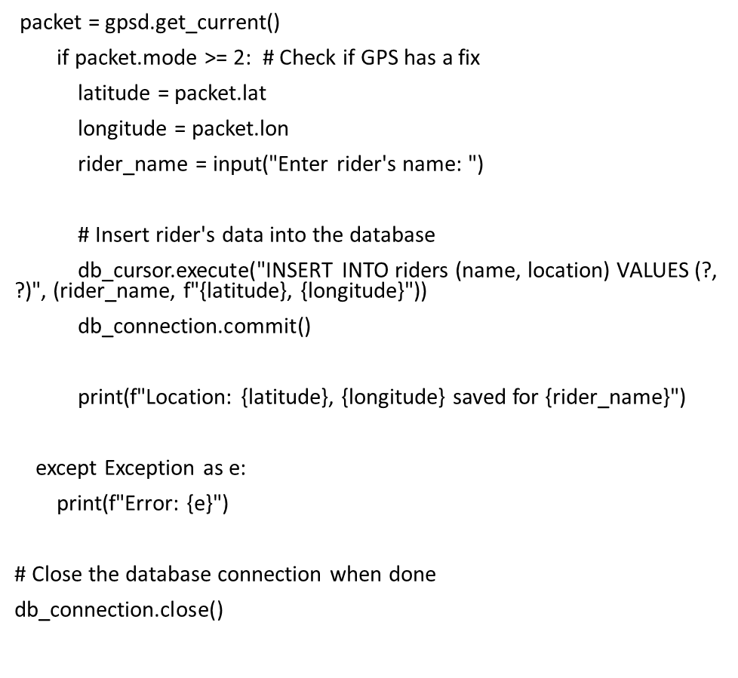
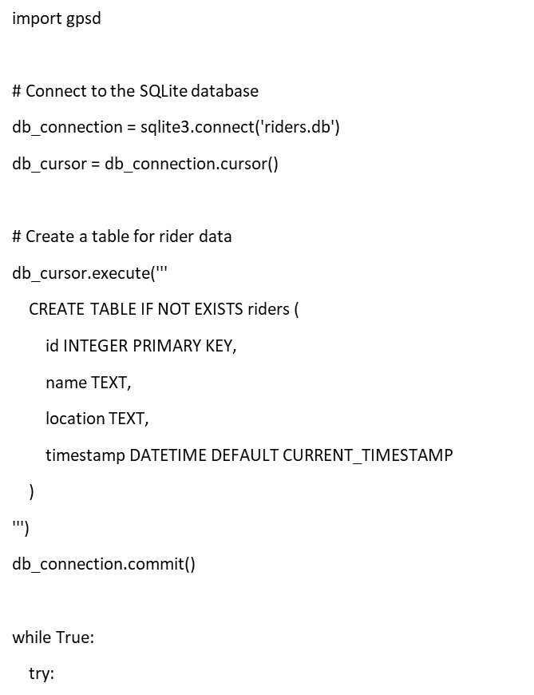
PYTHON PROGRAM

Slide 30
HARDWARE CONNECTIONS
Power Supply:
Ensure that the GPS module receives the required voltage. Most GPS modules operate at 3.3V, while the Raspberry Pi GPIO pins operate at 3.3V or 5V, depending on the model. Connect the GPS module to the Raspberry Pi's 3.3V or 5V pin and ground (GND) to provide power.
UART (Serial) Connection:
GPS modules often communicate using UART (serial communication). Connect the GPS module's TX pin to the Raspberry Pi's RX pin and the RX pin to the Raspberry Pi's TX pin. These connections allow the Raspberry Pi to receive GPS data via the serial interface.
Antenna:
Make sure to attach the GPS module's antenna to ensure it can receive signals from GPS satellites.

Slide 31
SOFTWARE CONFIGURATION
Enable UART:
By default, the UART hardware on the Raspberry Pi is usually used for console output. You may need to disable this functionality to use UART for your GPS module. You can do this through the Raspberry Pi Configuration tool (raspi-config) or by editing the config.txt file.
Install Required Software:
You will need software libraries to read and parse the GPS data. The most common library for this purpose is gpsd. You can install it using the following command
Aurdino
sudo apt-get install gpsd gpsd-clients
Configure gpsd:
After installation, you'll need to configure gpsd to use the UART port where your GPS module is connected. Open the /etc/default/gpsd file in a text editor, and set the DEVICES parameter to the serial device where your GPS module is connected.

Slide 32
Start gpsd: Start the gpsd service:
bash
Copy code
sudo systemctl enable gpsd
sudo systemctl start gpsd
Test the GPS Module: You can test your setup using the cgps tool, which comes with the gpsd-clients package. Run the following command:
Copy code
cgps -s
You should see live GPS data if your module is receiving signals.
Develop Your Application:
Once you've verified that your GPS module is working with the Raspberry Pi, you can develop your application to read and use the GPS data. You can use Python and libraries like gpsd-py3 or other programming languages to access and process the GPS data.

Slide 33
SUBMISSION PART
STEP TO BE FOLLOWED
1. Define Project Objectives:
Clearly define the objectives and goals of your public transportation optimization project. Determine what you want to achieve with the integration of GPS, Raspberry Pi, radar, and ultrasonic sensors.
2. Assemble Hardware:
Acquire the necessary hardware components, including the Raspberry Pi, GPS module, radar sensor, ultrasonic sensors, and any additional components like cameras, displays, or communication modules.

Slide 34
3. Install Operating System:
Install a suitable operating system (e.g., Raspberry Pi OS) on your Raspberry Pi.
4. Interface GPS Module:
Connect the GPS module to the Raspberry Pi's GPIO pins and configure the software to read GPS data. You can use Python libraries like gpsd-py3 to access GPS data.
5. Interface Radar Sensor:
Connect the radar sensor to the Raspberry Pi, making sure to follow the sensor's data sheet for wiring instructions. Install any necessary drivers or libraries to read data from the radar sensor.

Slide 35
6. Interface Ultrasonic Sensors:
Connect the ultrasonic sensors to the Raspberry Pi's GPIO pins. You may need to use a GPIO library, like RPi.GPIO in Python, to interface with the ultrasonic sensors.
7. Data Fusion:
Develop software to collect data from the GPS module, radar sensor, and ultrasonic sensors. Combine this data to create a comprehensive view of the vehicle's surroundings, including location, obstacles, and potential collisions.
8. Cloud Connectivity:
Set up cloud connectivity on the Raspberry Pi to send data to the cloud for remote monitoring and analysis. You can use cloud platforms like AWS, Azure, Google Cloud, or a custom server.
9. Data Transmission:
Write scripts to transmit the collected data to the cloud, utilizing secure and efficient communication protocols (e.g., MQTT, HTTP, or WebSocket).

Slide 36
10. Cloud Data Processing:
Configure the cloud environment to process and analyze the incoming data, applying algorithms for real-time decision-making and optimization.
11. Web Interface:
Develop a web-based interface that allows authorized personnel and passengers to access real-time information about the public transportation system. Consider using web technologies like HTML, CSS, JavaScript, and a web framework like Flask or Django for backend functionality.
12. Data Visualization:
Create interactive and informative data visualizations on the webpage, such as maps with real-time vehicle positions, obstacles, and estimated arrival times.
13. Alerts and Notifications:
Implement alerting and notification mechanisms on the webpage to inform users of critical events, delays, or safety issues.

Slide 37
14. Testing and Validation:
Thoroughly test the integrated system, ensuring that the GPS, radar, ultrasonic sensors, cloud connectivity, and webpage interface function correctly and that data is processed accurately.
15. Deployment:
Deploy the system on public transportation vehicles, ensuring that all hardware and software components are securely mounted and function in a real-world environment.
16. Monitoring and Maintenance:
Continuously monitor the system's performance, security, and data accuracy. Implement regular maintenance to address hardware wear and software updates.
17. User Training:
Provide training to public transportation operators, maintenance personnel, and other relevant stakeholders on how to use and maintain the system.
18. Evaluation and Optimization:
Regularly evaluate the system's performance against predefined objectives and optimize it based on user feedback and changing requirements.

Slide 38
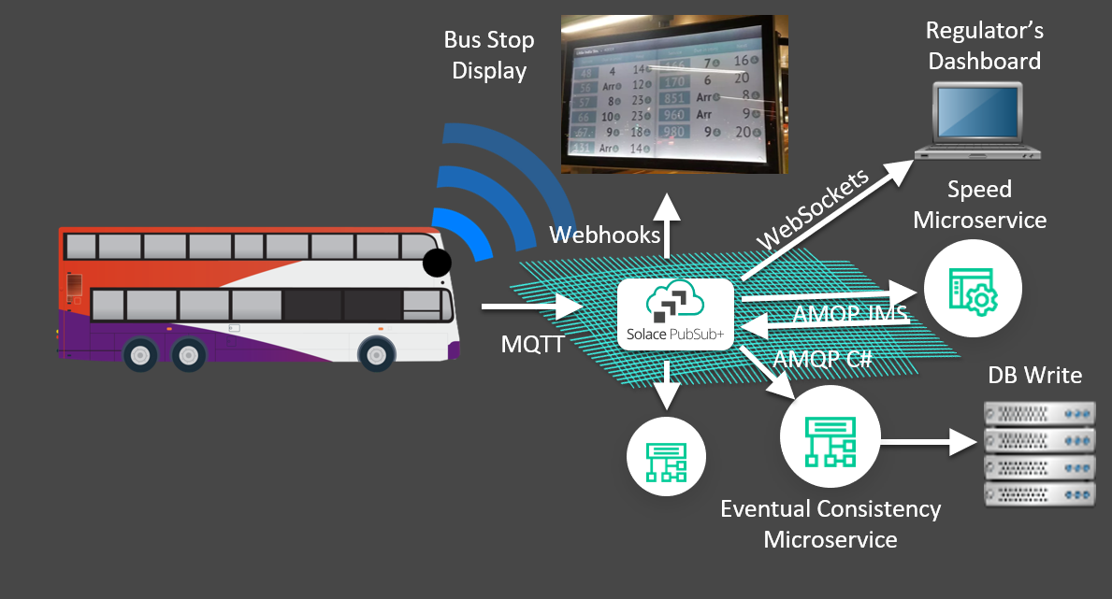
OUTPUT

Slide 39
CONCLUSION
In conclusion, the Public Transportation Optimization Project represents a significant step towards achieving safer, more efficient, and passenger-centric urban mobility. Through the integration of cutting-edge technologies such as GPS, Raspberry Pi, radar, and ultrasonic sensors, coupled with cloud connectivity and a user-friendly web interface, we have revolutionized the way we manage and enhance public transportation systems.
This project has empowered us to monitor and respond to real-time data, ensuring the safety of passengers and pedestrians, optimizing routes, and minimizing delays. The web-based interface offers passengers and transportation authorities a transparent view of the system's status, promoting informed decision-making and a seamless travel experience.
As our cities continue to grow, it is imperative that we invest in innovative solutions to tackle congestion, reduce emissions, and improve the quality of urban life. This project is a testament to our commitment to embracing technology for the betterment of public transportation and the communities we serve. By staying agile, continuously optimizing, and listening to the needs of our passengers, we pave the way for a more sustainable and efficient future in urban mobility.

